Slide 1
Marketplace Design & User Story
2020.6.1

Slide 2
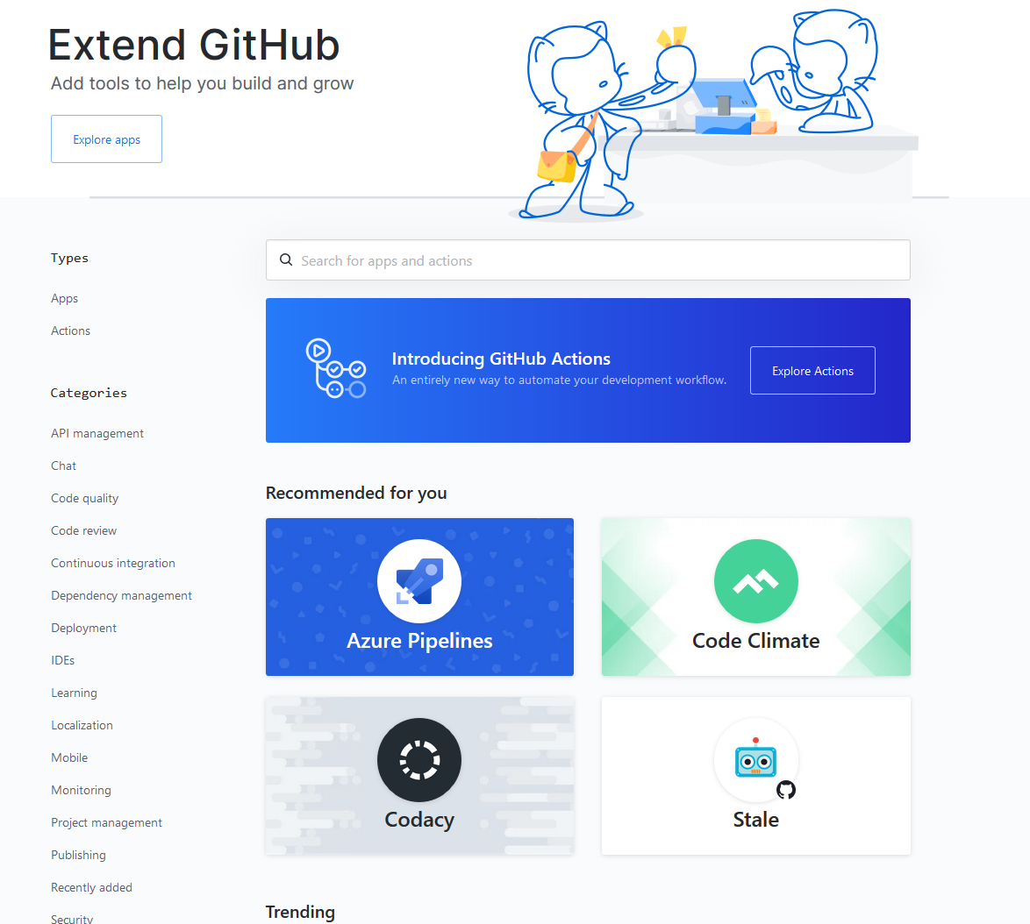
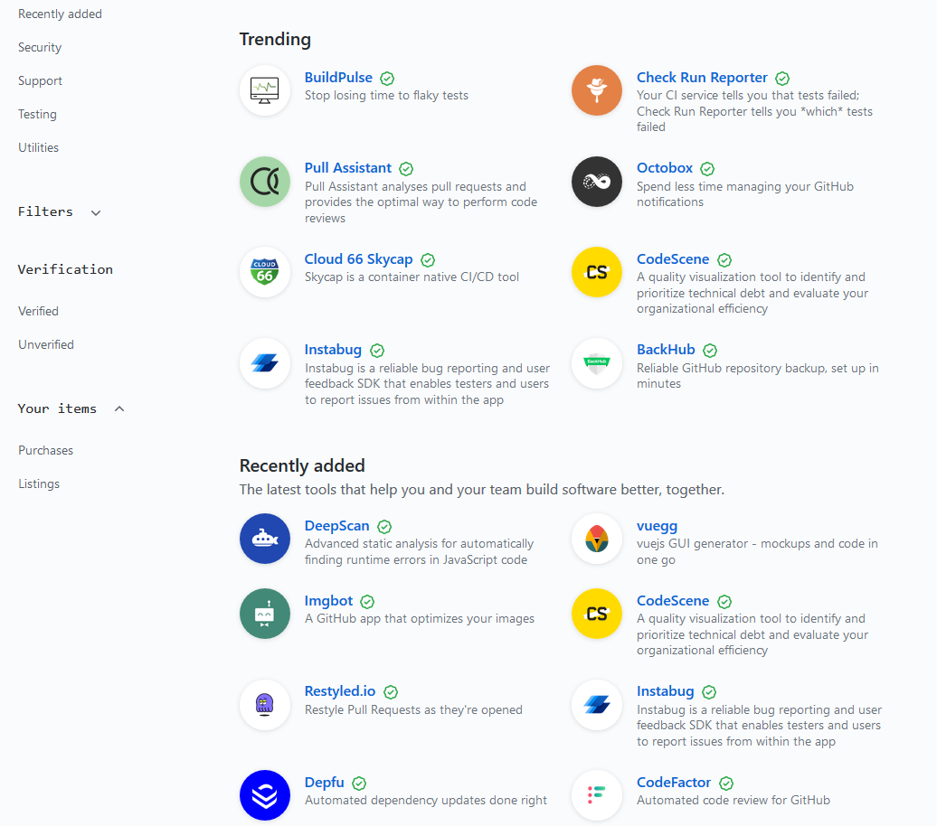
Reference – Github Marketplace
Types
Categories
Recommend
Trending
Recent
Notes:
Validate each module config with corresponding schema
Validate globalConfig with all schemas.
Validate each dependency module config with all corresponding schemas.
Allow default value
Only submodule appears in config will be processed

Slide 3
Types
Data
lower bound: share folder
upper bound: cloud storage service (access control, visualization, management, user)
Model
code or model file
Image
docker environment
Job
Image + Model + Data + Resource (platform related config)
Tutorial
Notes:
Validate each module config with corresponding schema
Validate globalConfig with all schemas.
Validate each dependency module config with all corresponding schemas.
Allow default value
Only submodule appears in config will be processed

Slide 4
Types
Data
Summary
Description
Data Explorer
Notes:
Validate each module config with corresponding schema
Validate globalConfig with all schemas.
Validate each dependency module config with all corresponding schemas.
Allow default value
Only submodule appears in config will be processed

Slide 5
Discussion
Embedded or Standalone
Issues if embedded:
- Using pai auth and user management will limit multi platform support
Notes:
Validate each module config with corresponding schema
Validate globalConfig with all schemas.
Validate each dependency module config with all corresponding schemas.
Allow default value
Only submodule appears in config will be processed

Slide 6
Work Items
Data
lower bound: share folder
upper bound: cloud storage service (access control, visualization, management, user)
Model
code or model file
Image
docker environment
Job
Image + Model + Data + Resource (platform related config)
Tutorial
Notes:
Validate each module config with corresponding schema
Validate globalConfig with all schemas.
Validate each dependency module config with all corresponding schemas.
Allow default value
Only submodule appears in config will be processed

